Slide 1
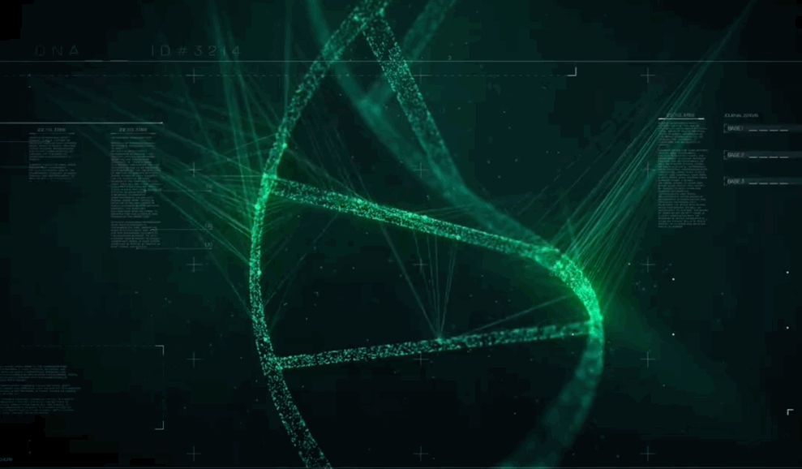
UltraGene
Presented by: Cristian, Dana, KC, Zi

Slide 2
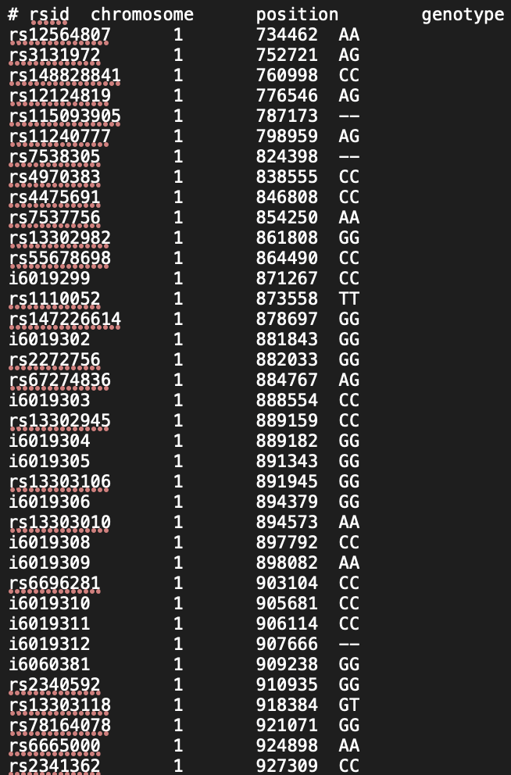
Background
<Problems> It’s hard to understand the meaning behind 23andME gene raw data.

Slide 3
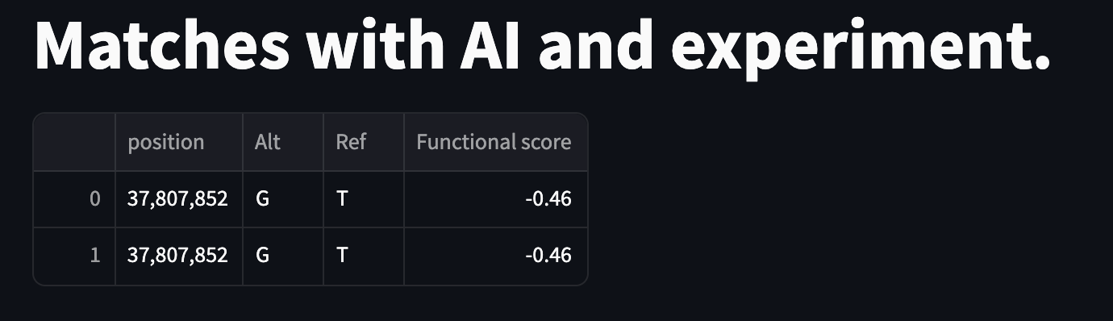
Background
<Solution>
Ｗe provide customer with a platform to conduct searches and comparisons to identify high-risk genes.

Slide 4

User Story
Michael got his genetic report from 23andMe and is eager to find out his personal genetic information and family genetic history.
UltraGene can simplify the complexity of genetic analysis, uncover potential genetic anomalies in a user-friendly manner.
Notes:
wants insights into his personal genetic information and family genetic history
UltraGene can help a beginner like Michael to simplify the complexity of genetic analysis. This approach enables him to uncover potential genetic anomalies in a user-friendly manner, providing clear and accessible insights into personal genetic information, without requiring deep scientific knowledge.

Slide 5

Intro to UltraGene
23andMe
MaveDB
AlphaMissense
Notes:
The tool is designed to run a matching operation of the genetic report with two database, MaveDB and Alphamissense.
MaveDB: a public repository for multiplexed assays of variant effect (MAVE) datasets, that measures functional impact of missense genetic variants.
AlphaMissense: is a machine learning-based computational tool designed to predict the functional effects of missense mutations;
No database can claim to have information on all genetic mutations, here we use multiple dataset for more accurate matching operation
By checking the genetic data against these two database, we can provide user with a more comprehensive understanding of their genetic data emphasizing any potential health risks.

Slide 6
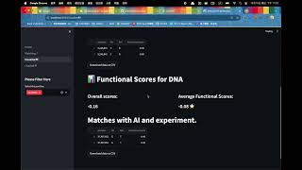
Demo

Slide 7

Results & highlight
Information obtained from UltraGene:
gene position
functional score
FAQ with chat bot
identifies and suggests the most dangerous DNA positions

Slide 8
Future work
Incorporation of Additional Databases ( aim for Open Source ) :
EX - data on genetic inheritance patterns Autosomal Dominant vs Recessive (i.e., 1 or 2 copies of the gene need to be defective to cause disease)
Support for Multiple Data Formats:
Expand the data input compatibility to accept various formats (ex. WGS, Exome )
Move beyond exclusive support for 23andMe SNP Chip data.

Slide 9
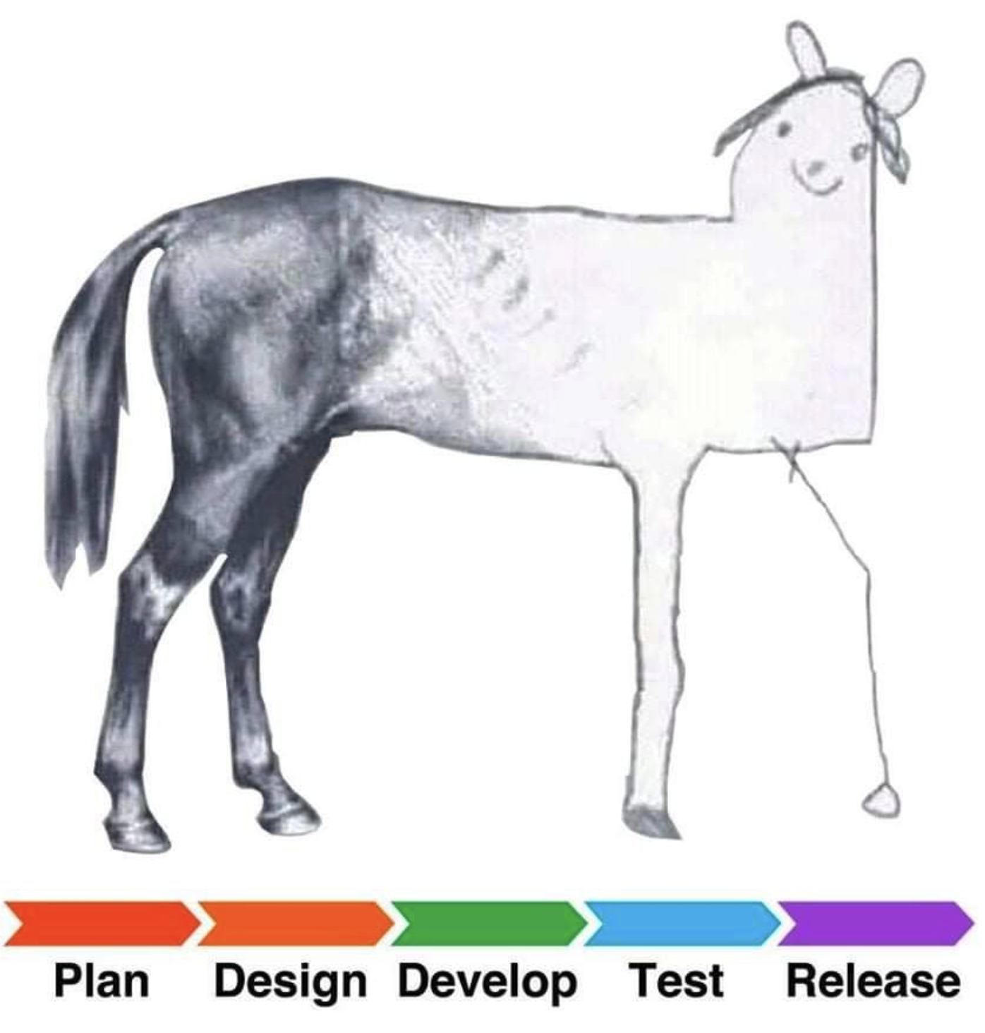
Questions ?

